Slide 1
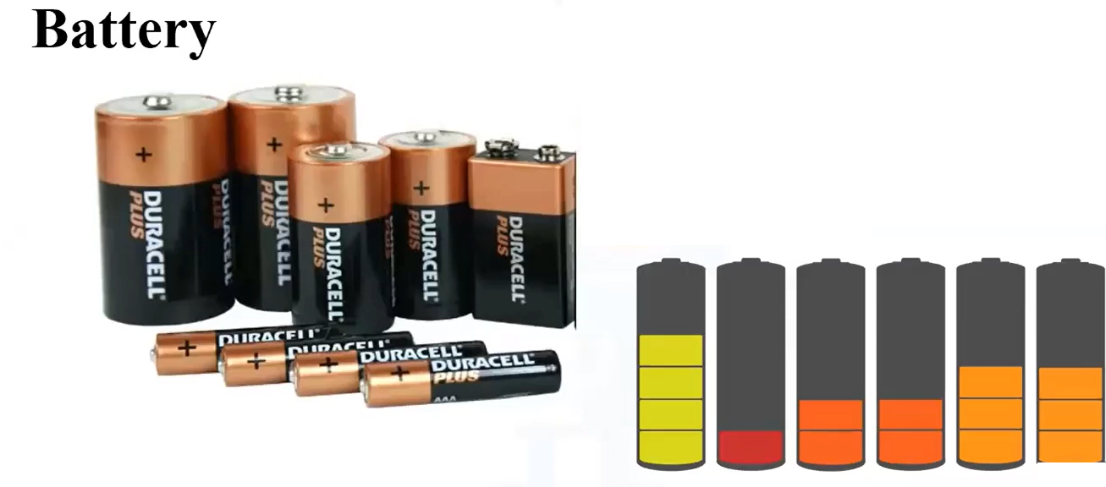
Difference between a cell and a battery
By Jatasya Raval

Slide 2
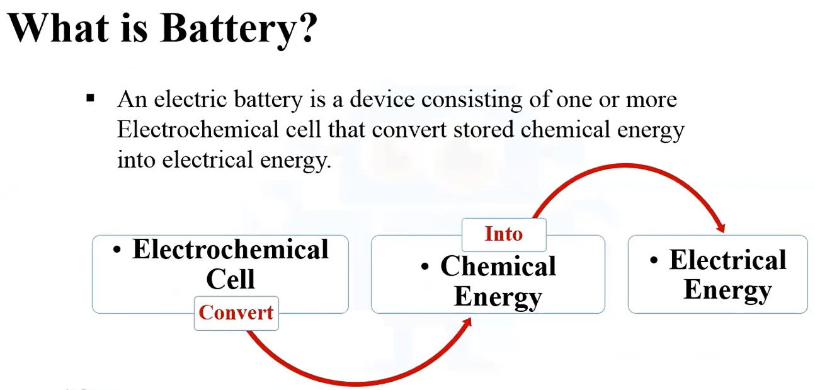
What is a Battery?

Slide 3
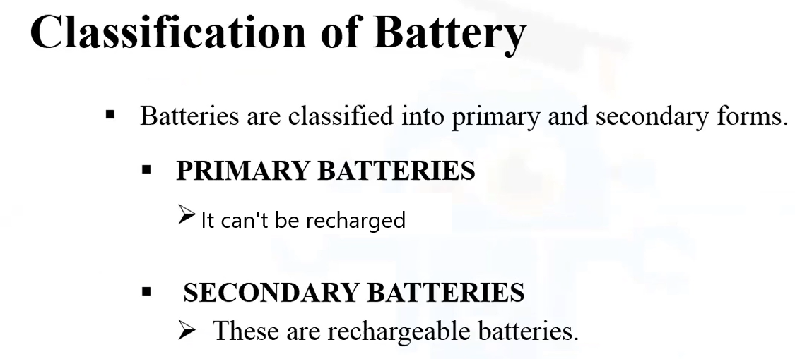
Classification of Battery

Slide 4

Primary Battery

Slide 5


Slide 6
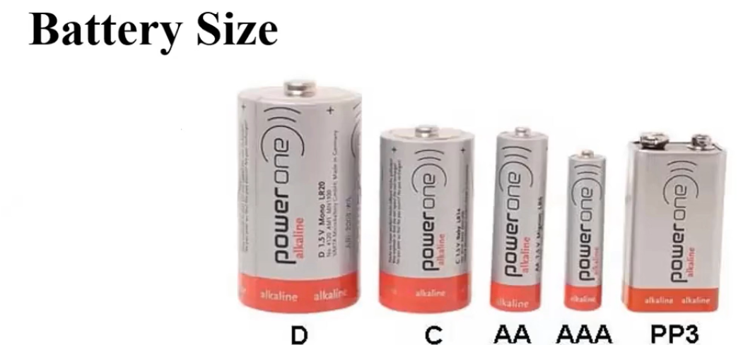
Battery Size
The importance of the format of a battery or a battery is crucial in buying criteria. If you make a mistake in the dimensions of your battery it will not fit into its housing and will be unusable. You must check the size or just the code of the format of the element.

Slide 7
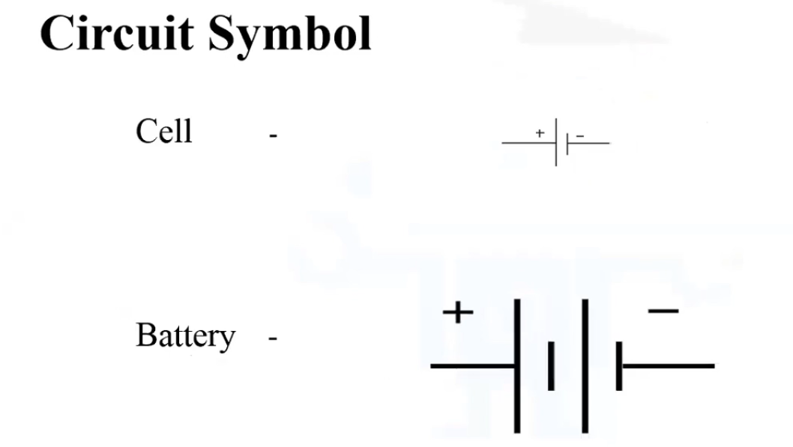
Circuit Symbol

Slide 8
Thank you
By Jatasya Raval

